Slide 2

Welcome to the
Minnesota State
High School
Mathematics League

Slide 3

Where we strive to create
A Culture of Coolness

Slide 4


The “Coach in a Box” Initiative
What you’ll find inside
Our Mission

Slide 5
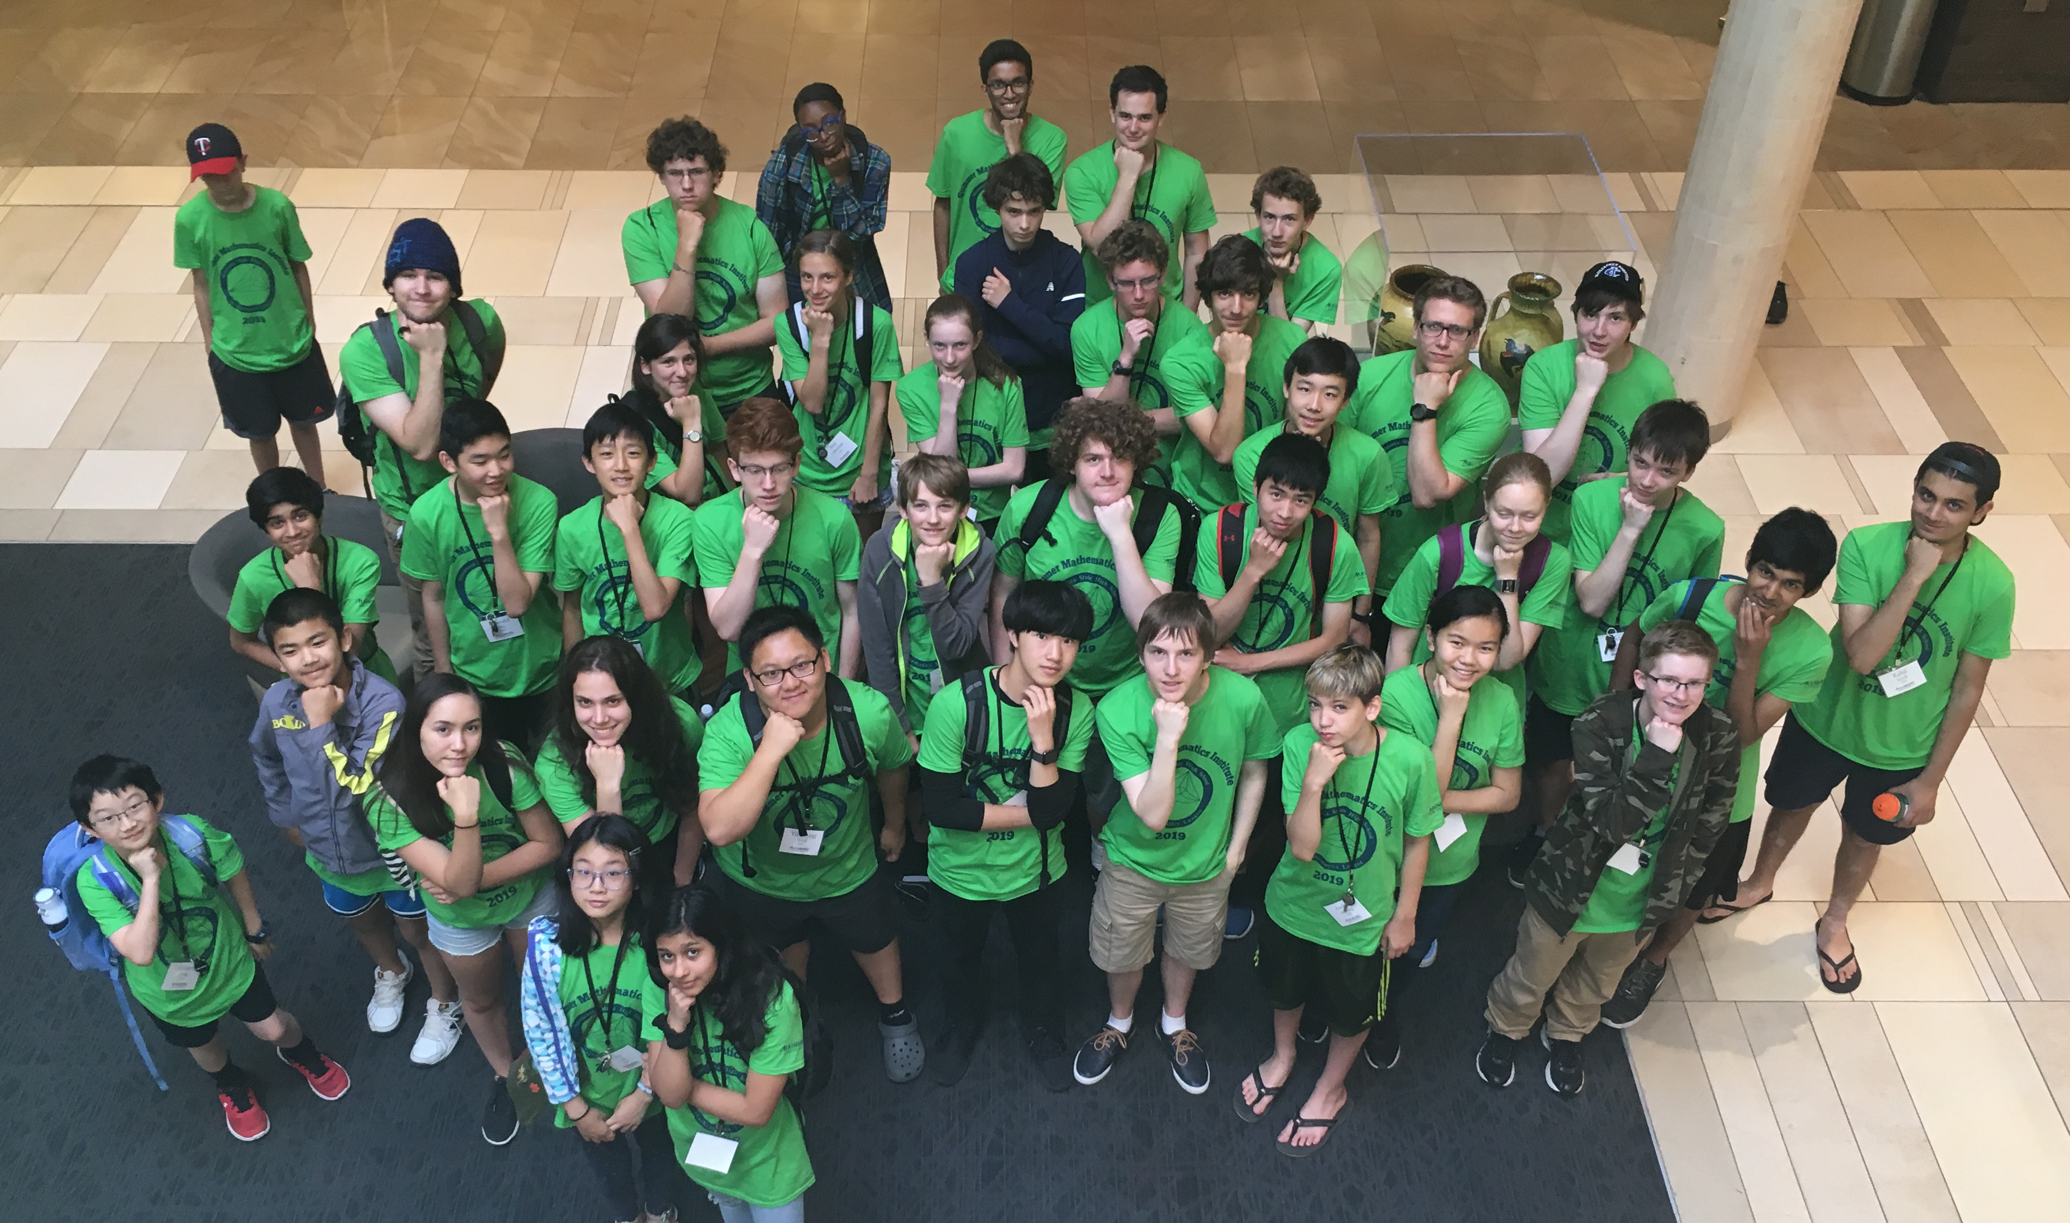
The League exists to identify students who have exceptional mathematical ability or interest, to give them recognition and encouragement, to bring them together with similar students, and to give them the opportunity to study topics not commonly taught in the high school curriculum.
Our Mission

Slide 6
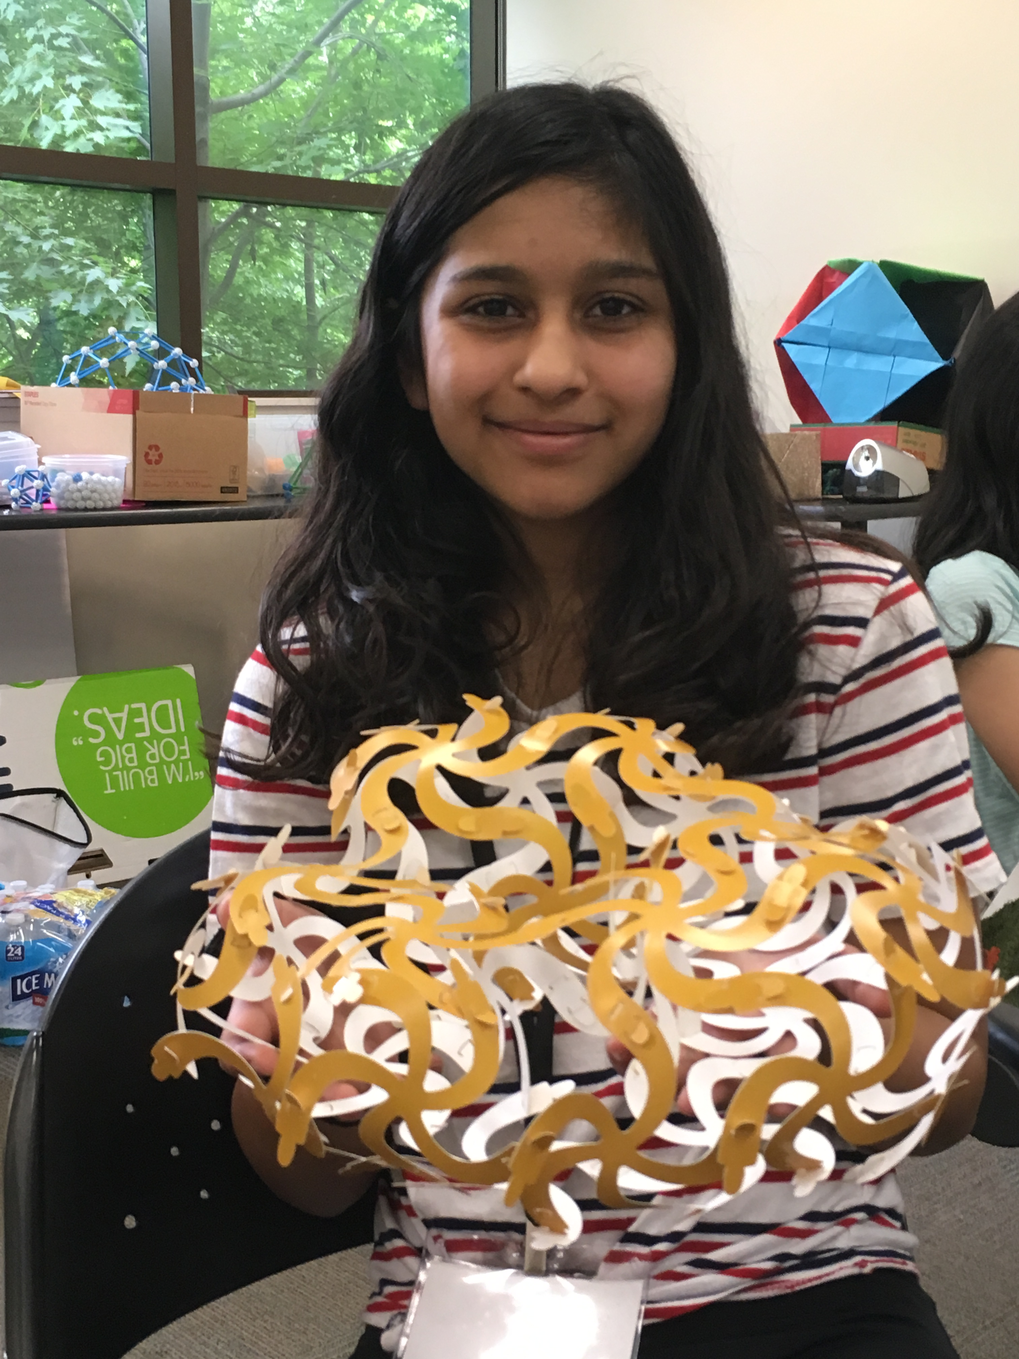
League activities are designed to challenge students with high and exceptional mathematical ability, but also seek to influence general mathematics education. We believe that a program like ours is shortsighted if it is not also developed in a way that strengthens mathematics education for all students.
Our Mission

Slide 7

Our students say it best

Slide 8


Be Cool

