Slide 2


Welcome to the
Minnesota State High School
Mathematics League
How to get Practice Materials for Students

Slide 3
Now that you’re registered, you need to start practicing!
But first, students need to know what they should work on
Each meet consists of 3 different individual events and one team event
For lack of better labels, the individual events are called Event A, Event B, and Event C
Roughly, Event A is Algebra and other Topics
Event B is Geometry and Trigonometry Topics
Event C is Counting, Probability and Statistics, Number Theory
At each meet, students take all 3 tests

Slide 4
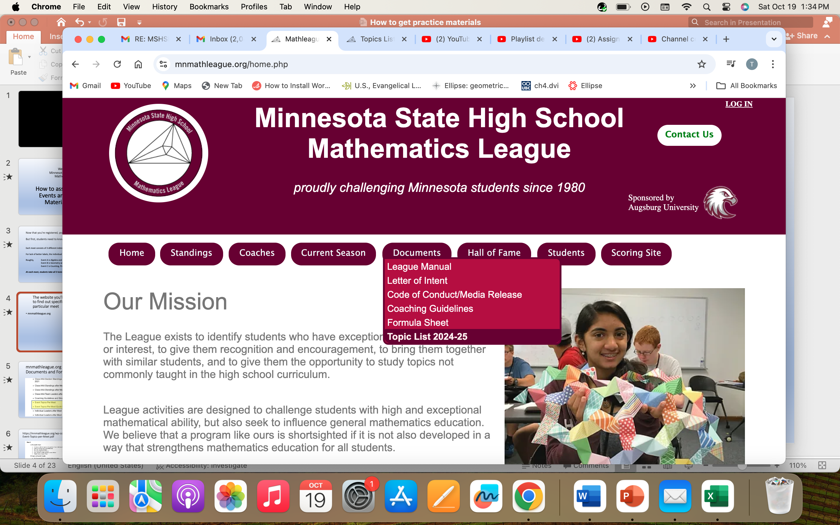
The website you’ll use to find out specific topics for a particular meet
mnmathleague.org

Slide 5
Go to Documents and click on topic list

Slide 6
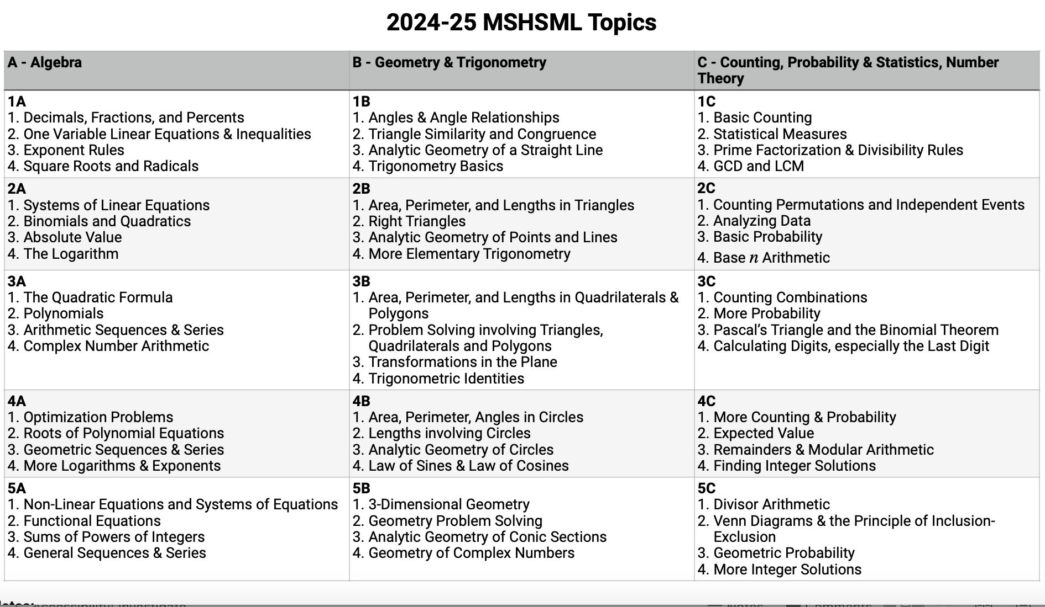
Knowing the topics will help students prepare for events

Slide 7
You’ll have to assign 8 “varsity” students
Schools can have as many students on the team as they want, but only 8 predetermined students constitute the scoring team for a particular meet. All other students are competing for individual honors.
NOTE: when picking your 8 varsity players, at least 2 have to be 10th grade or younger

Slide 8
Of note:
The 8 “varsity” students take the team test after Event C is done.
They are able to collaborate during the team test

Slide 9
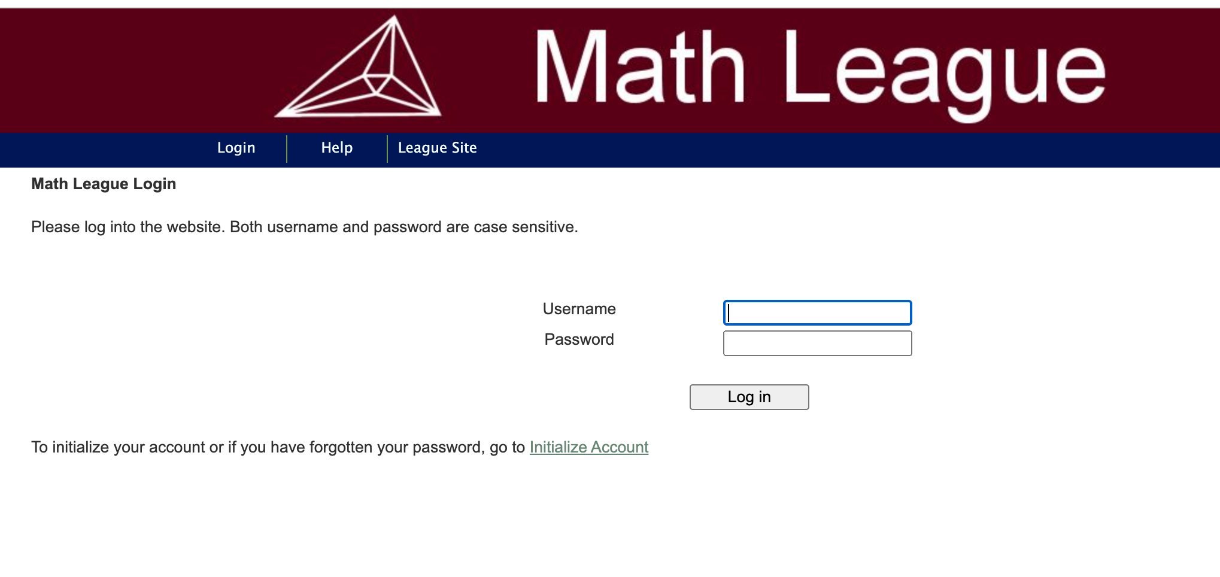
The website you’ll use to help with creating practice materials
mnmathleague.org and Click on scoring site

Slide 10
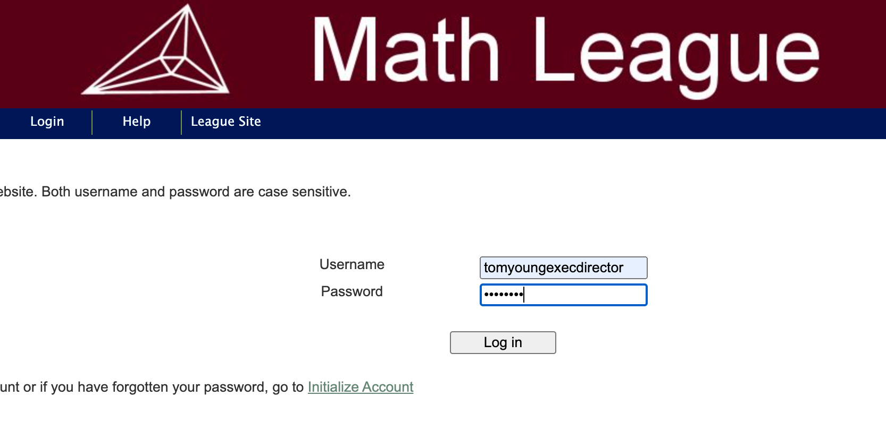
We’ll get you set up in the system so that you’ll have a login and password. Details on how this works will be emailed to you
mnmathleague.org and Click on League Site

Slide 11
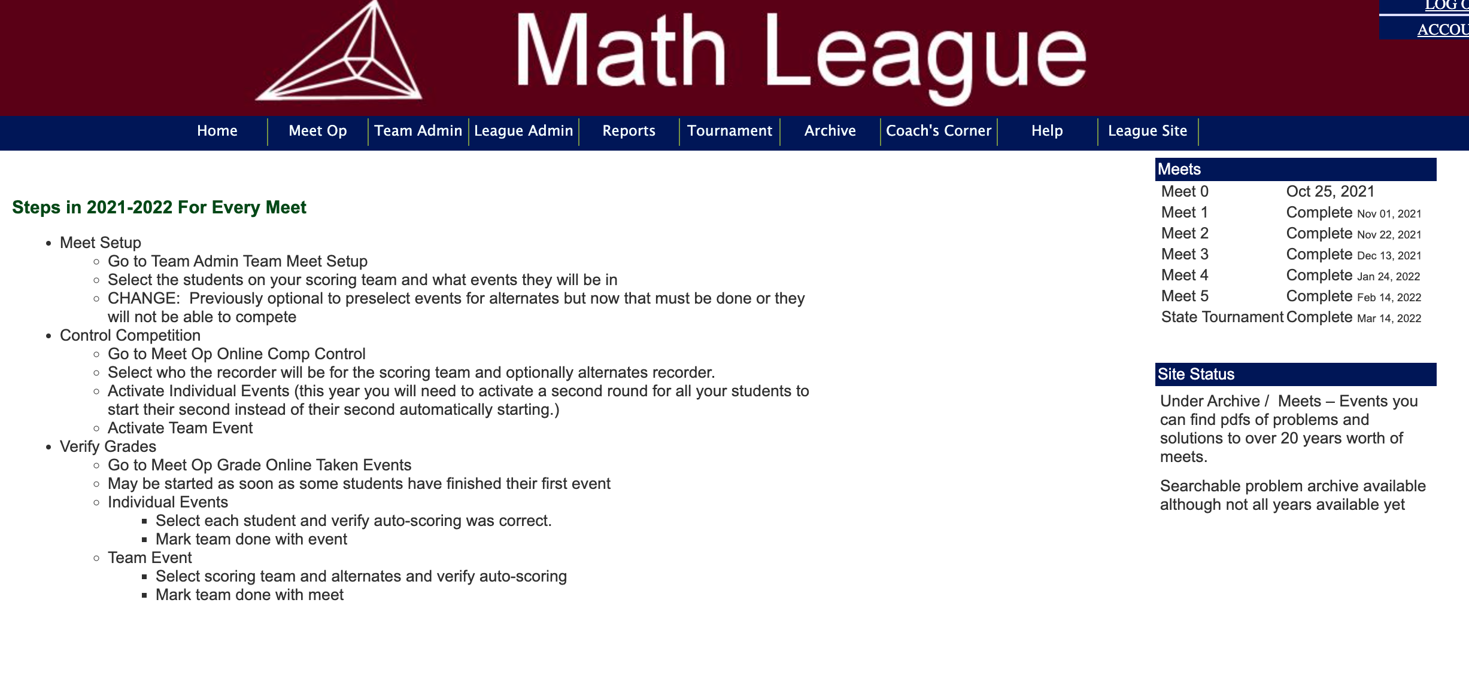
There are many features on this website that you will use. We are going to concentrate on the parts that help with practices
Click on Archive

Slide 12
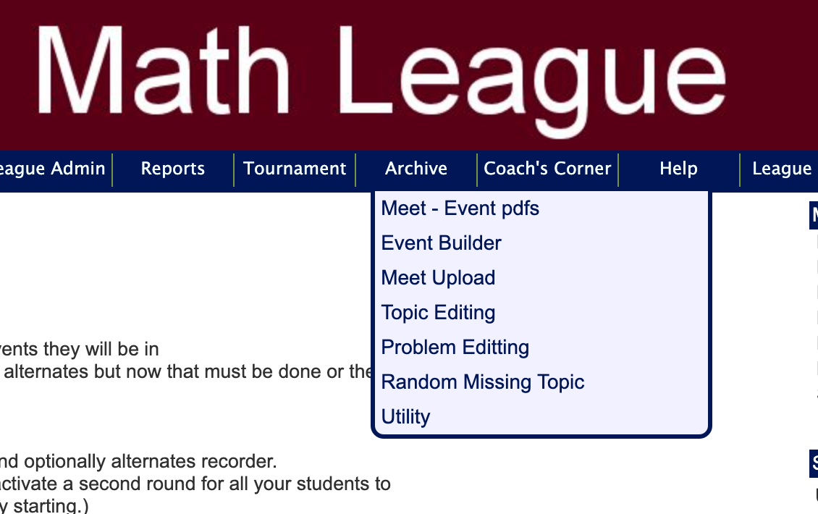
When you click on Archive you’ll see
Click on Meet – event pdfs

Slide 13
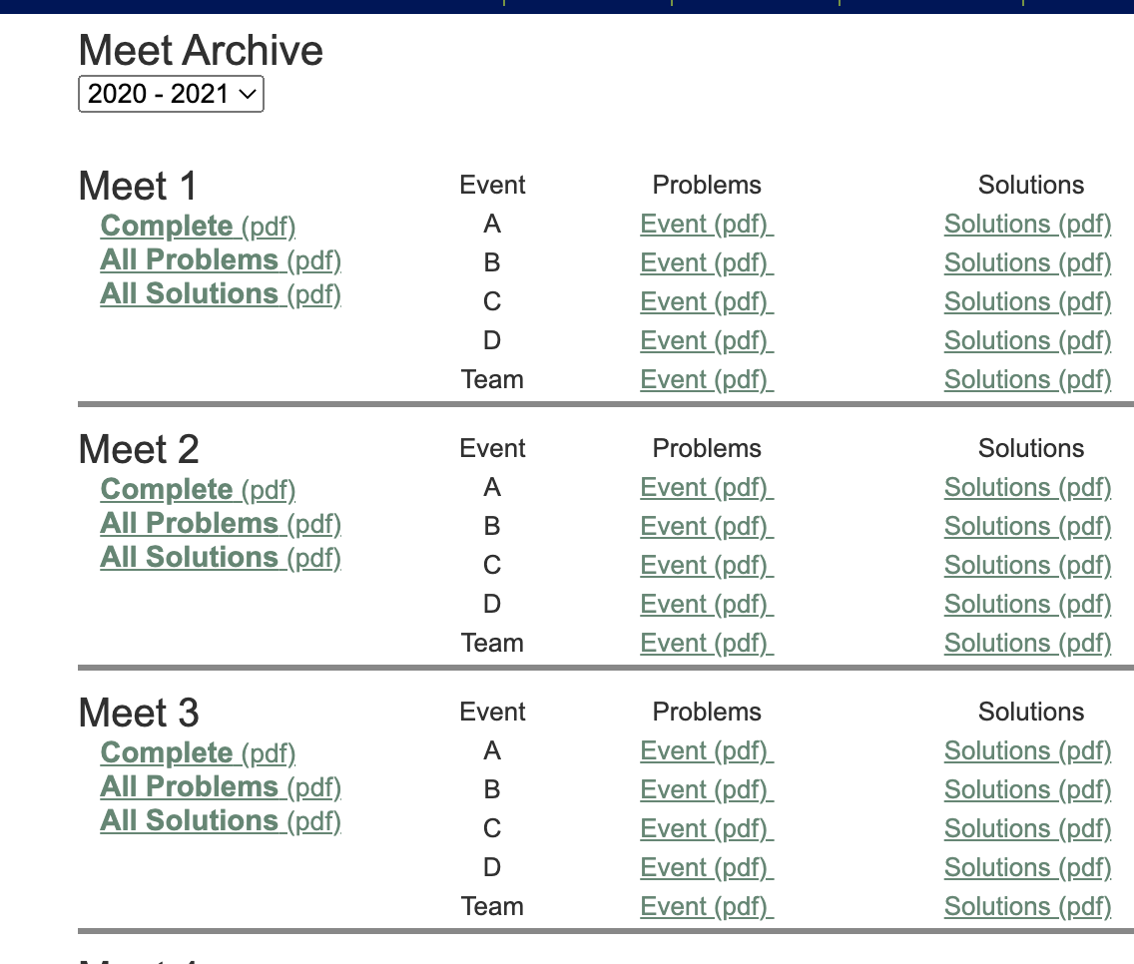
When you click on Meet events you’ll see
Events from every year from 1980 to present are stored
Try clicking on Event C

Slide 14
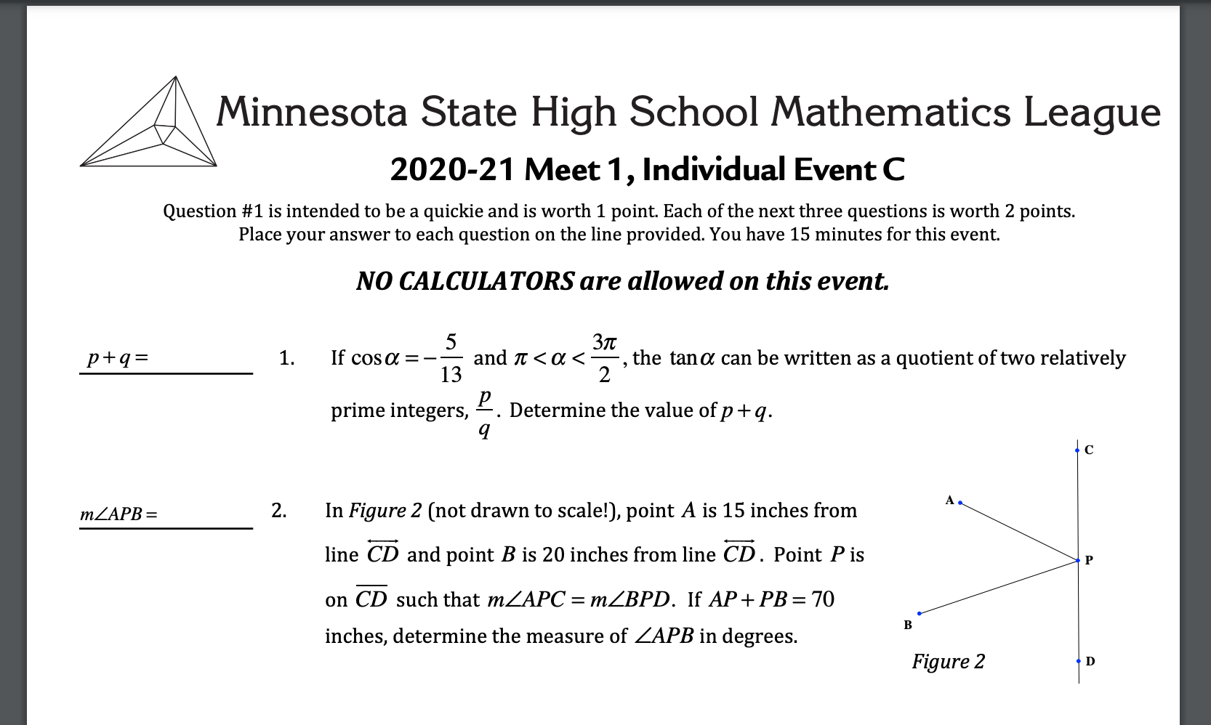

Slide 15
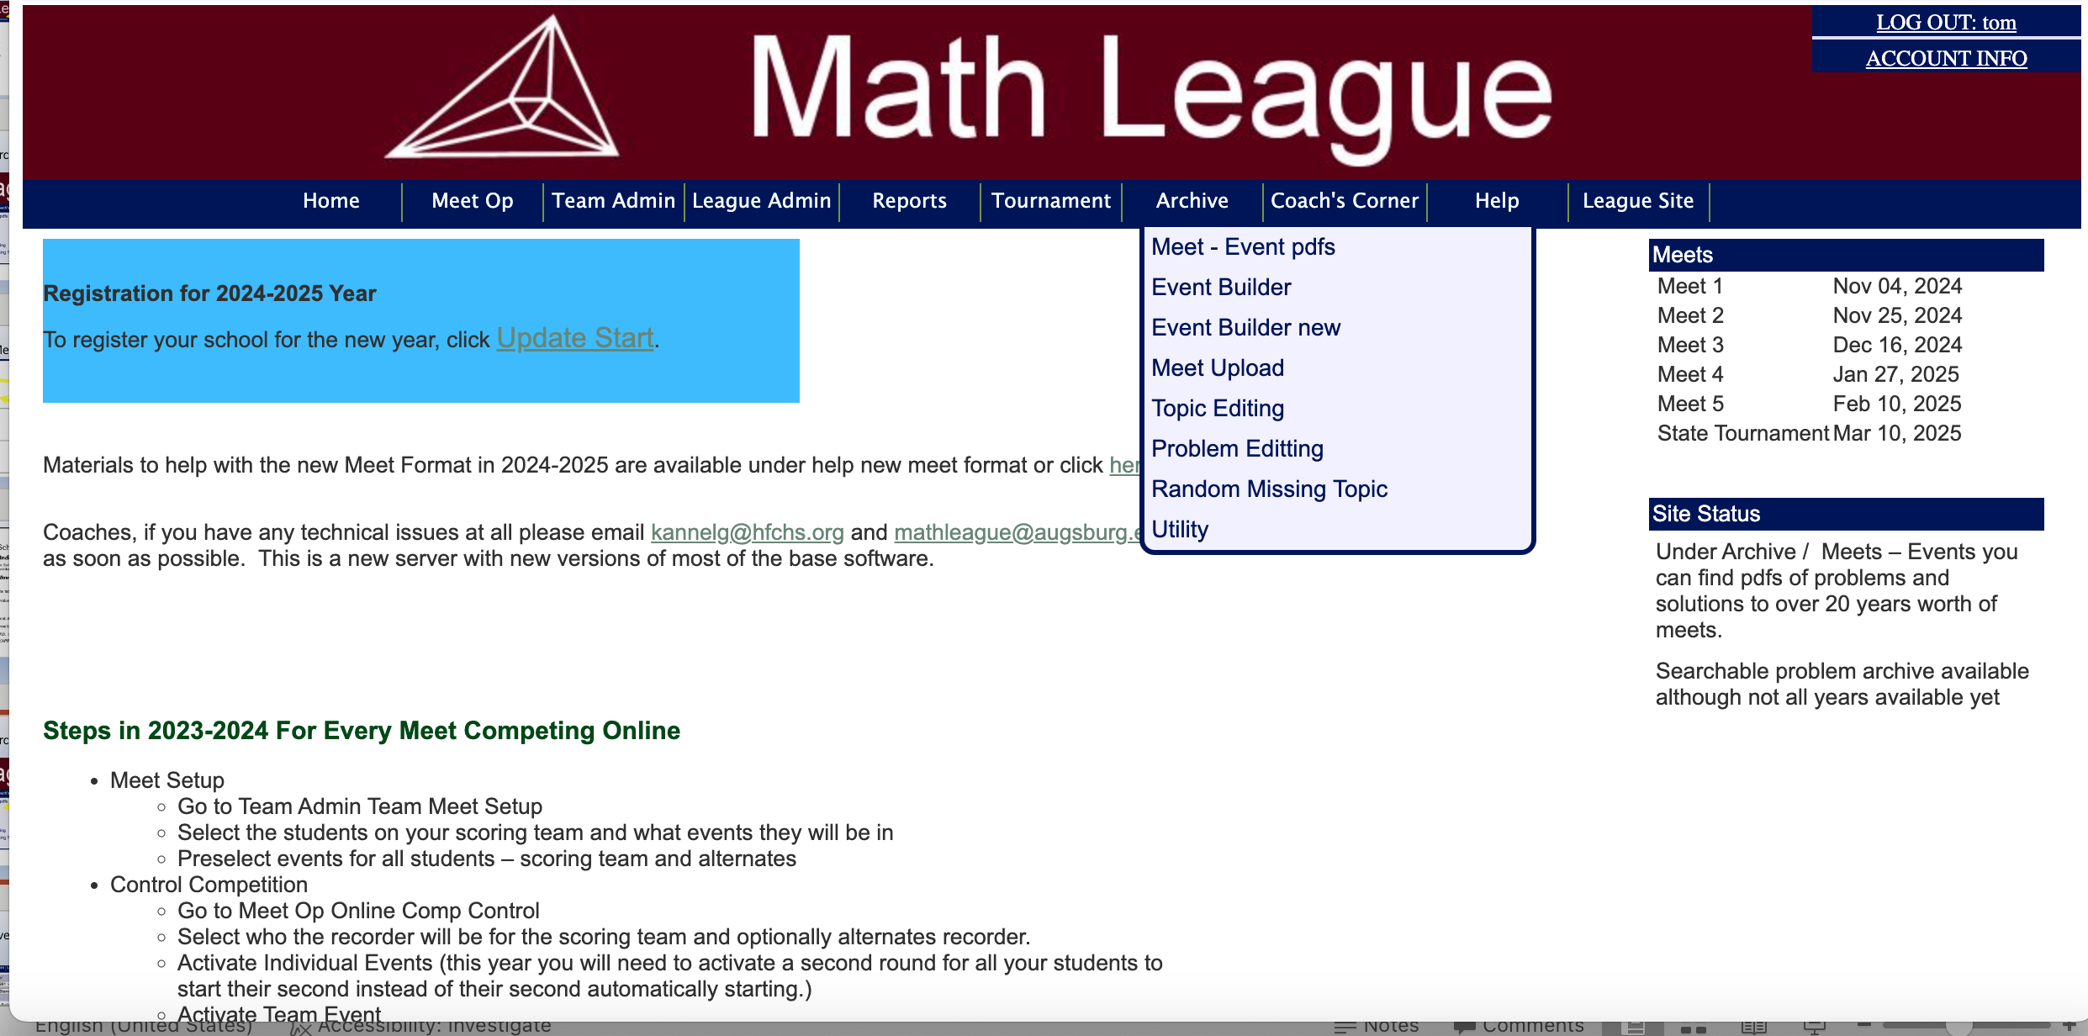
When you click on Archive you’ll see
Click on Event Builder new

Slide 16
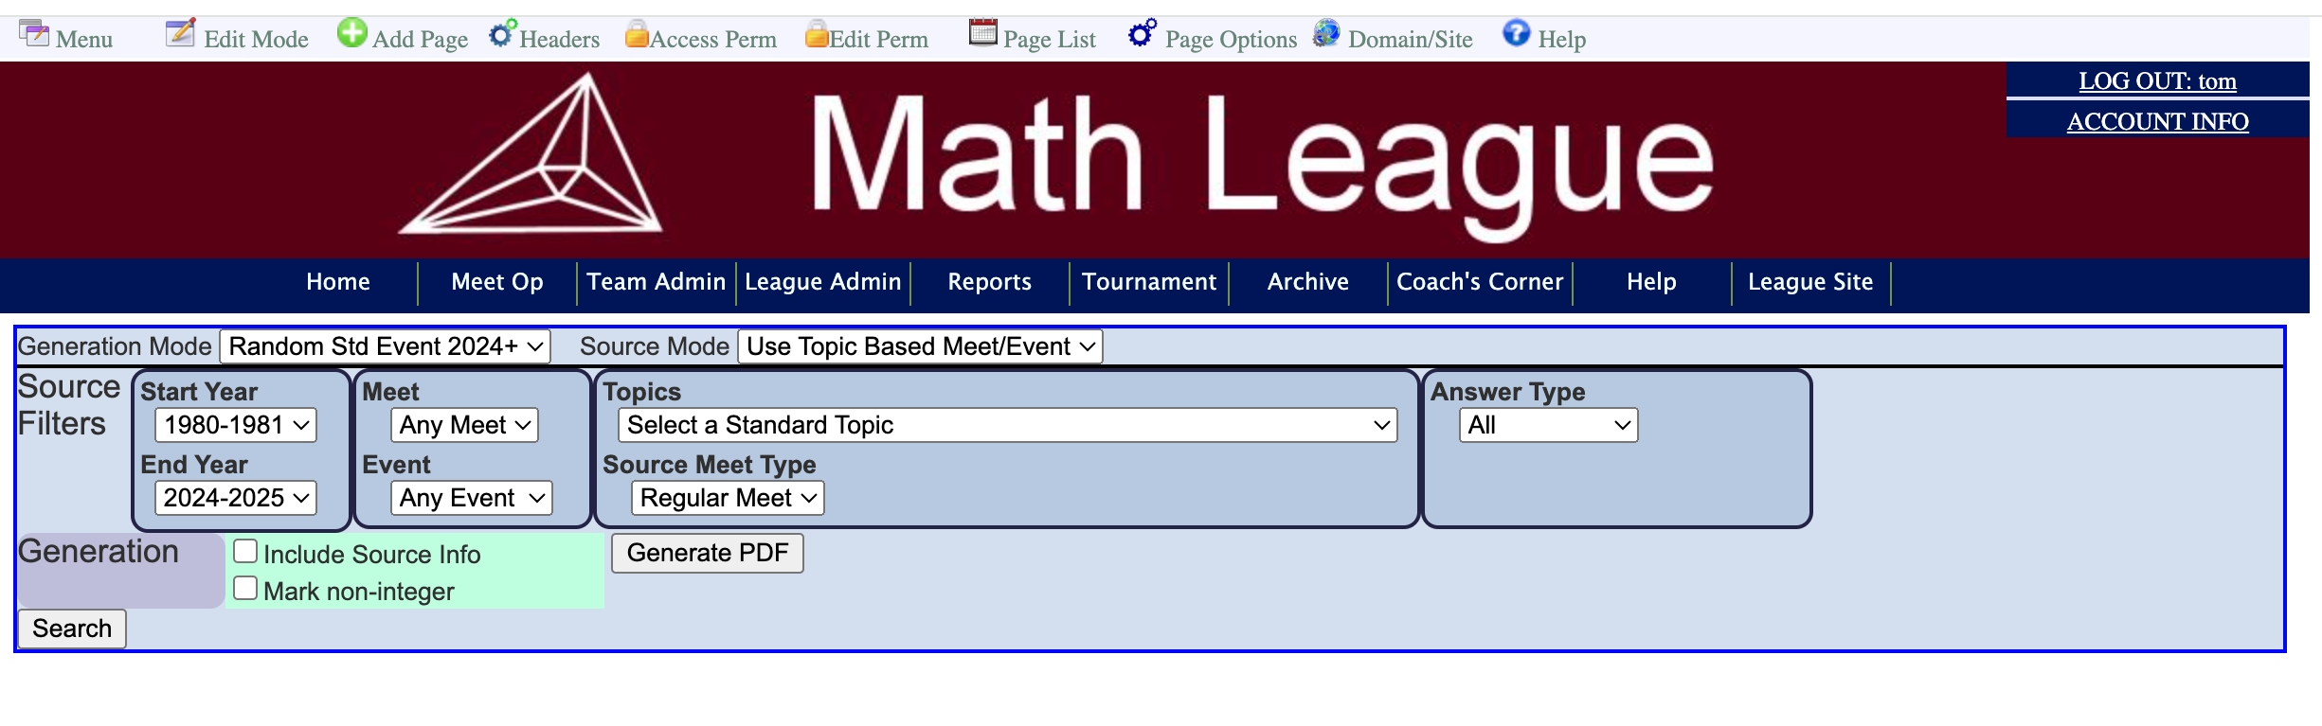
When you click on Event Builder you’ll see
Explore!

Slide 17
So you can find practice problems by year and meet or you can find practice problems by topic

Slide 18
Go.Math.Team.

