Slide 2


MN State HS Math League
Scoring System Training
Part Two:
Assigning Events and Passwords to Students
Picking a time slot to compete
A few cool videos to show students

Slide 3
What to do now
Access mnmathleague.org and Click on League site
Entering Students into the System
Assign Passwords and Events
Pick a time slot

Slide 4
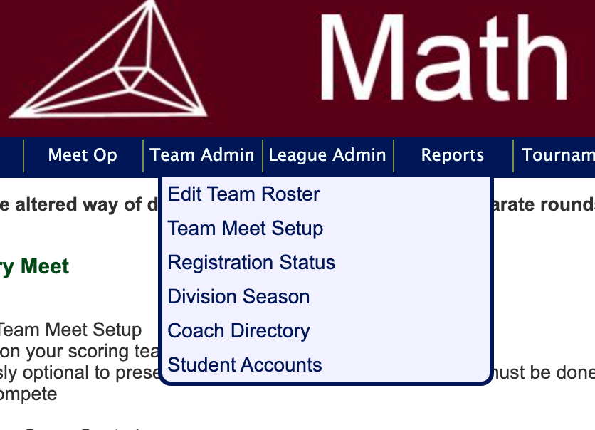
2. Enter student names for your team
Click on Team Admin: the screen should look like this
Click on Edit Team Roster

Slide 5
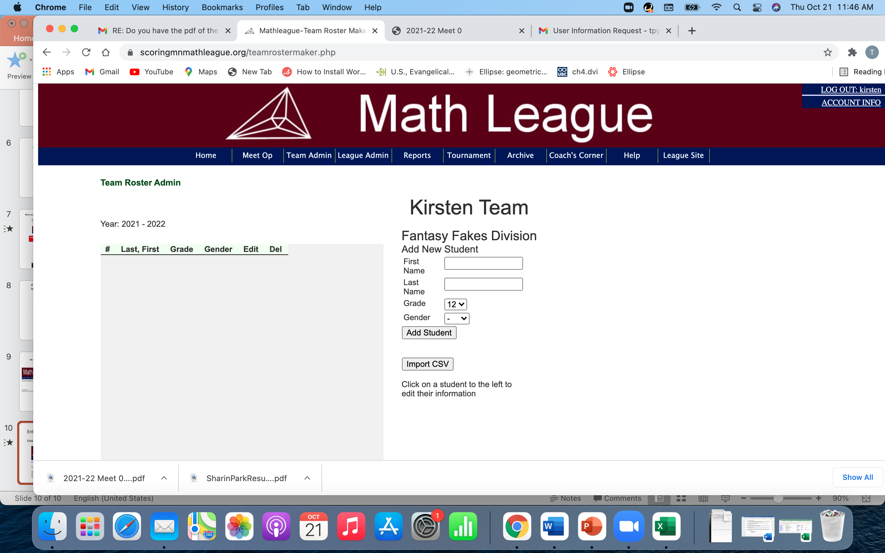
Your screen should look like this
Add your students

Slide 6
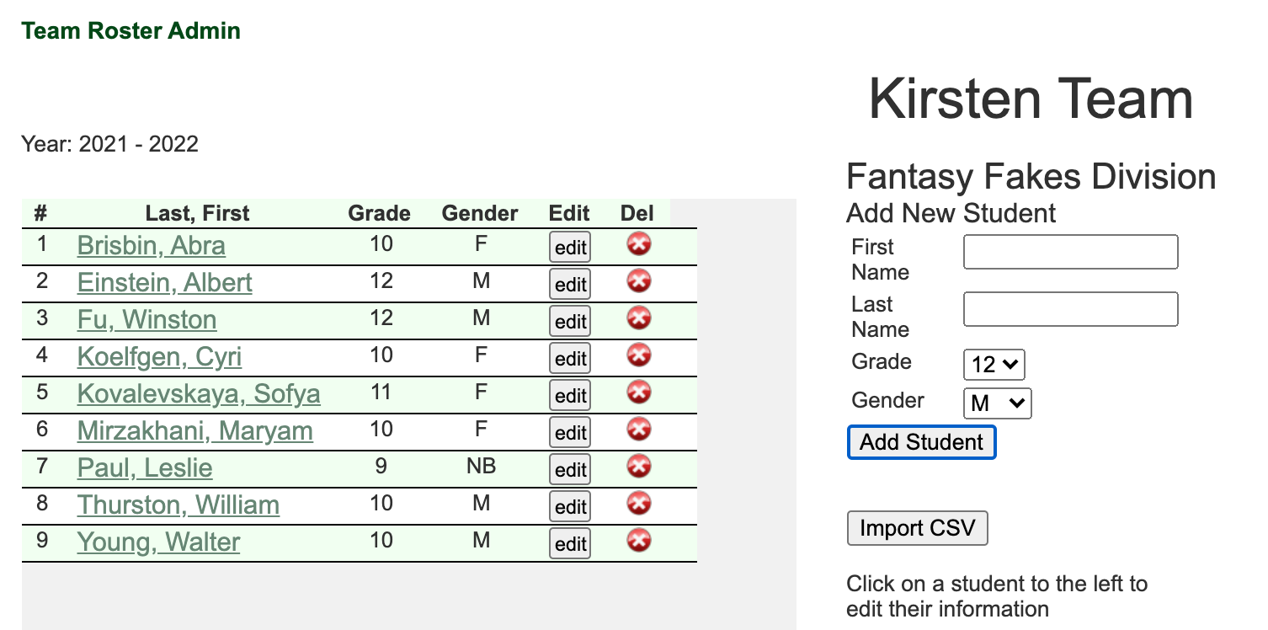
Enter the students that you have participating. You can always enter (or delete) others later.
When you are done, your screen should resemble this:

Slide 7
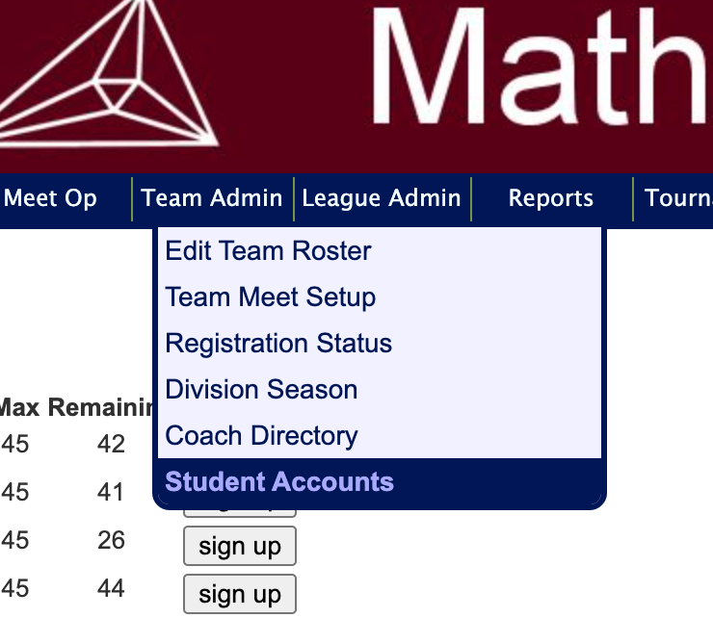
Assign students accounts to log in with:
Click Team Admin, then Student Accounts
Theoretically, this should only have to be done at the beginning of the year, not at each meet

Slide 8
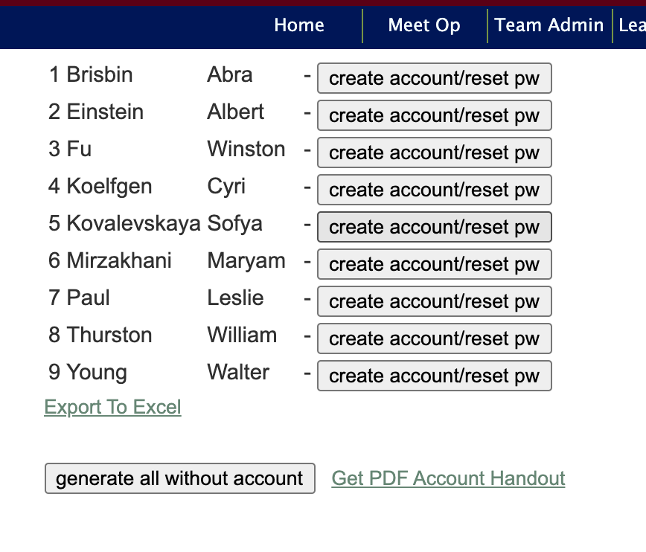
You can generate accounts individually,
but first time through hit the “generate all without an account”

Slide 9
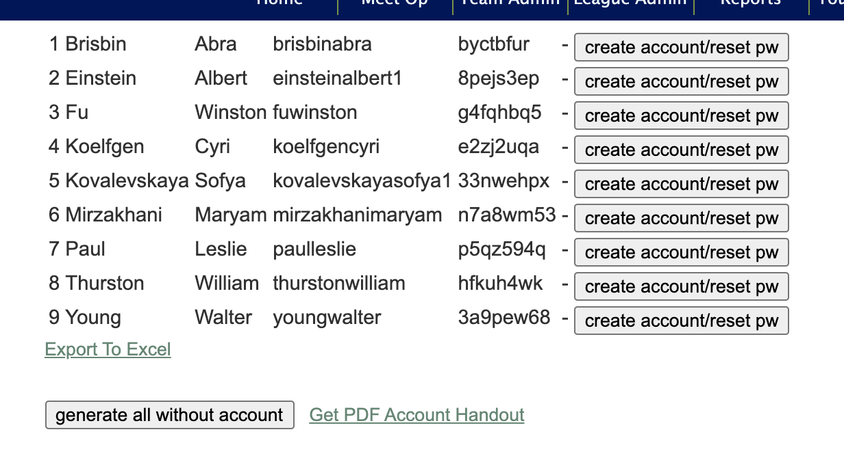
The program automatically generates a username and password for each student.
These need to be used wisely. If a student forgets their password or username,
you can provide it. Best way? Click on “Get PDF Account Handout”

Slide 10
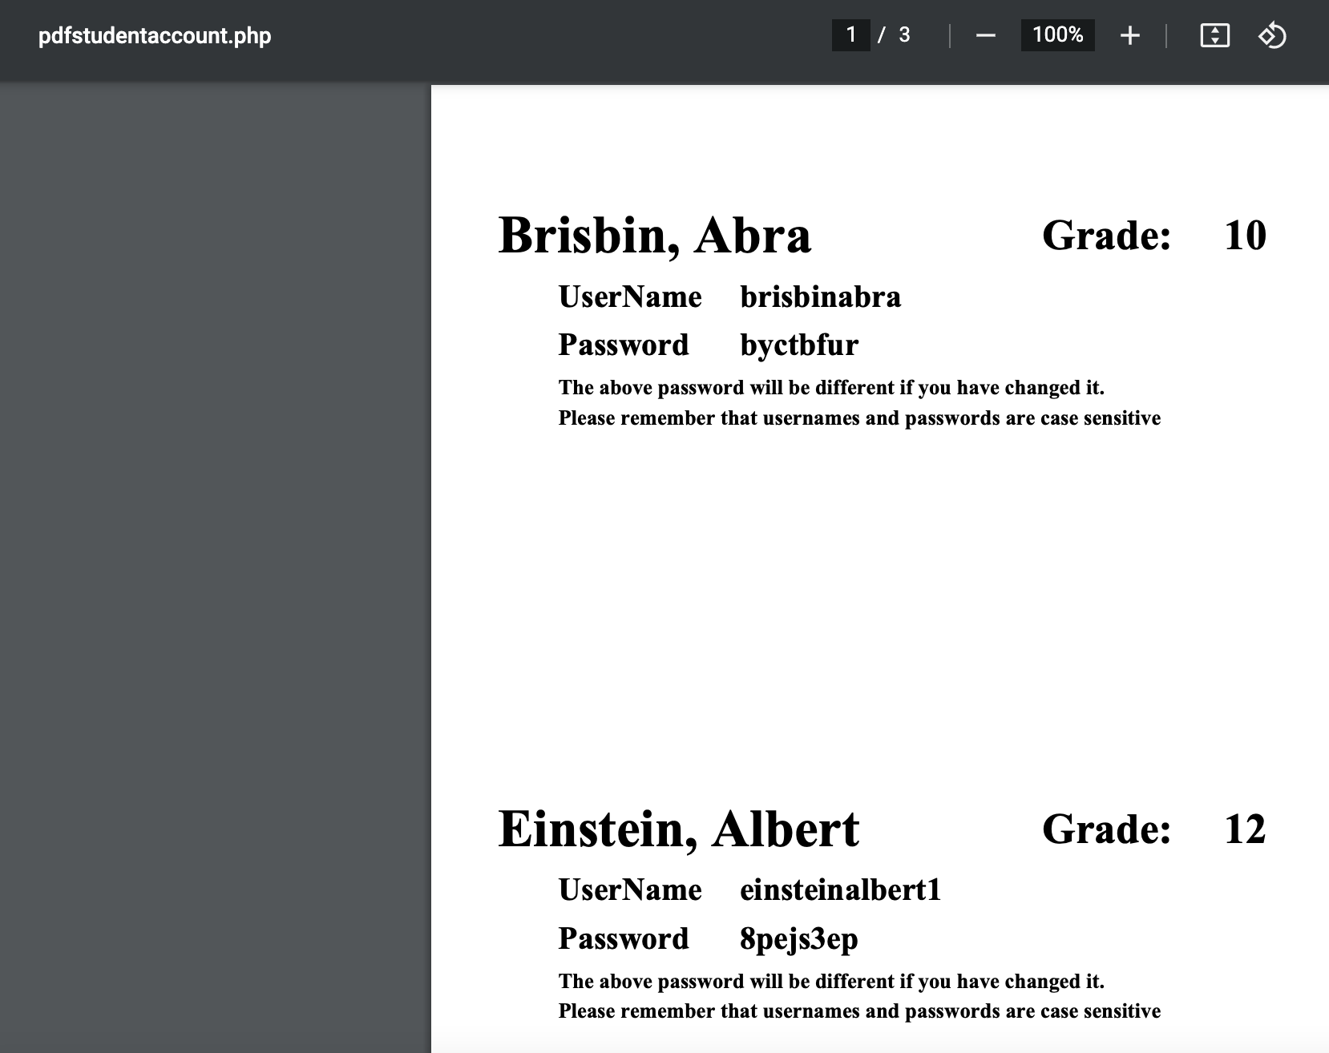
Clicking “Get PDF Account Handout makes a PDF that you can print and cut up and distribute

Slide 11
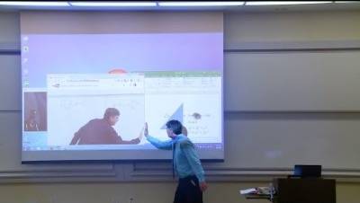
Math teachers contribute to the culture of coolness

Slide 12
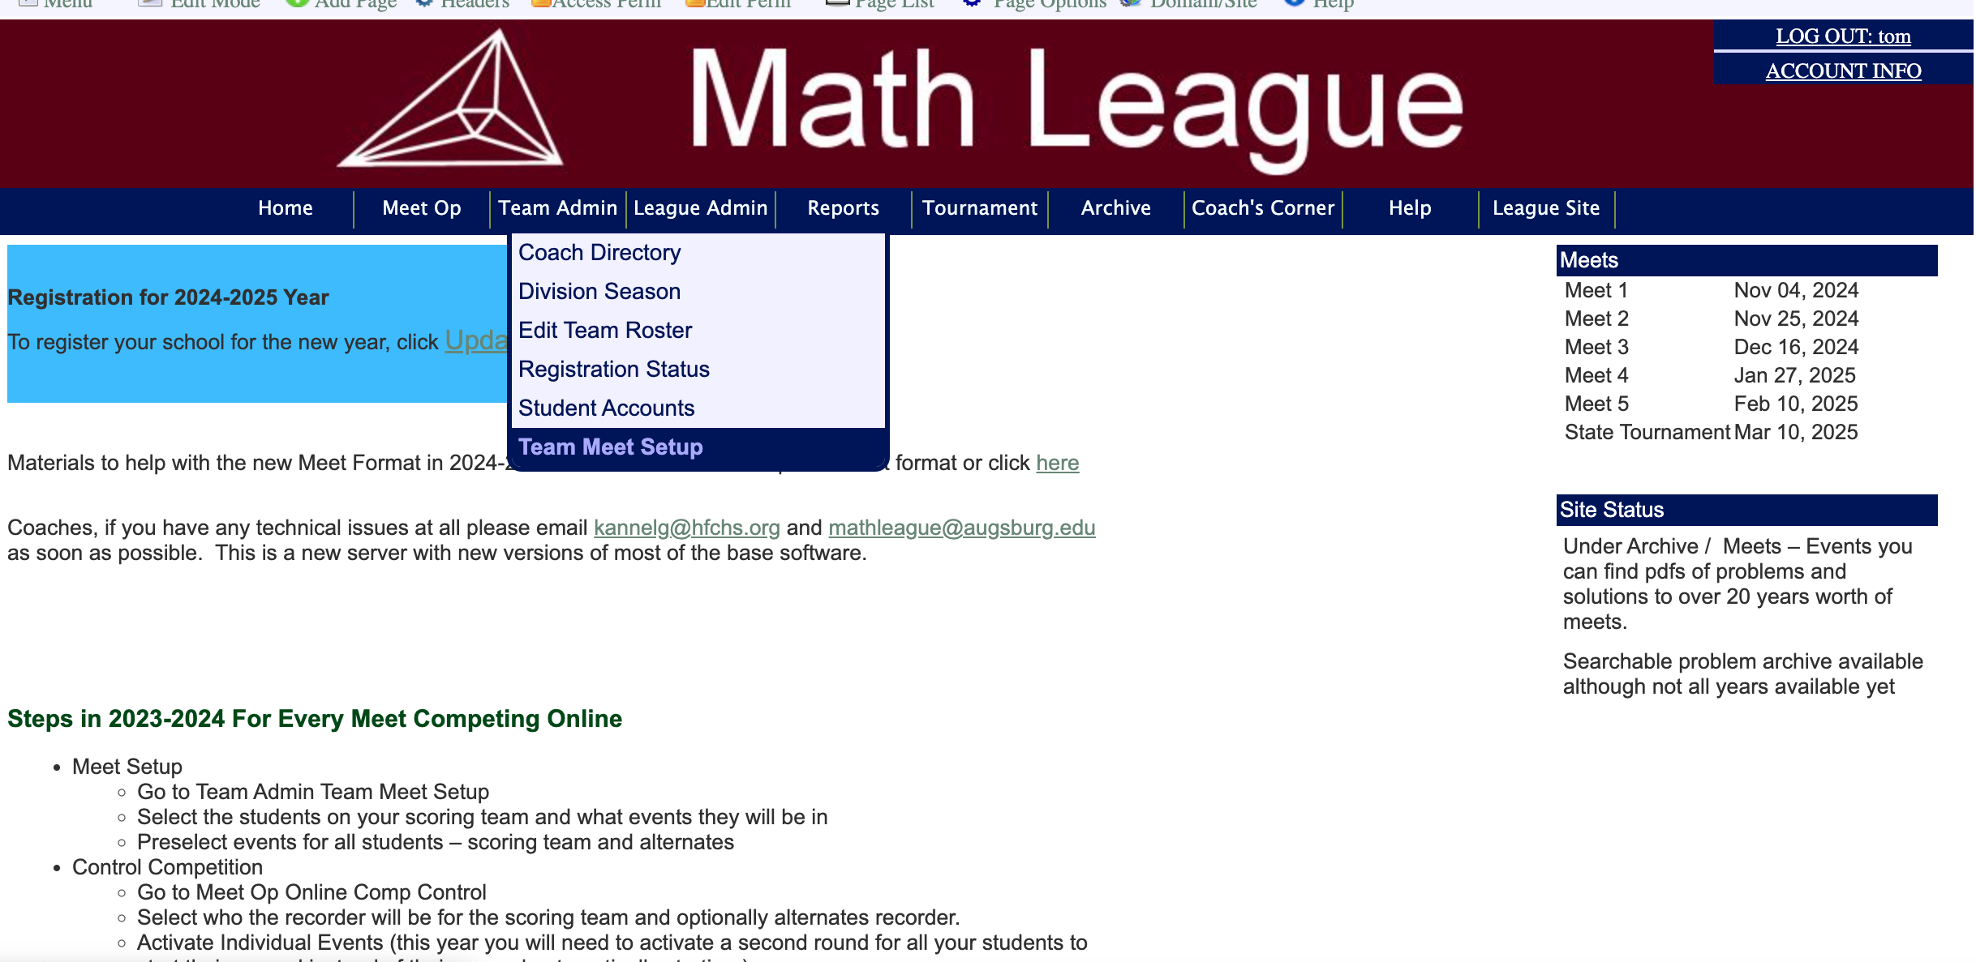
Click on Team Admin > Team Meet setup

Slide 13
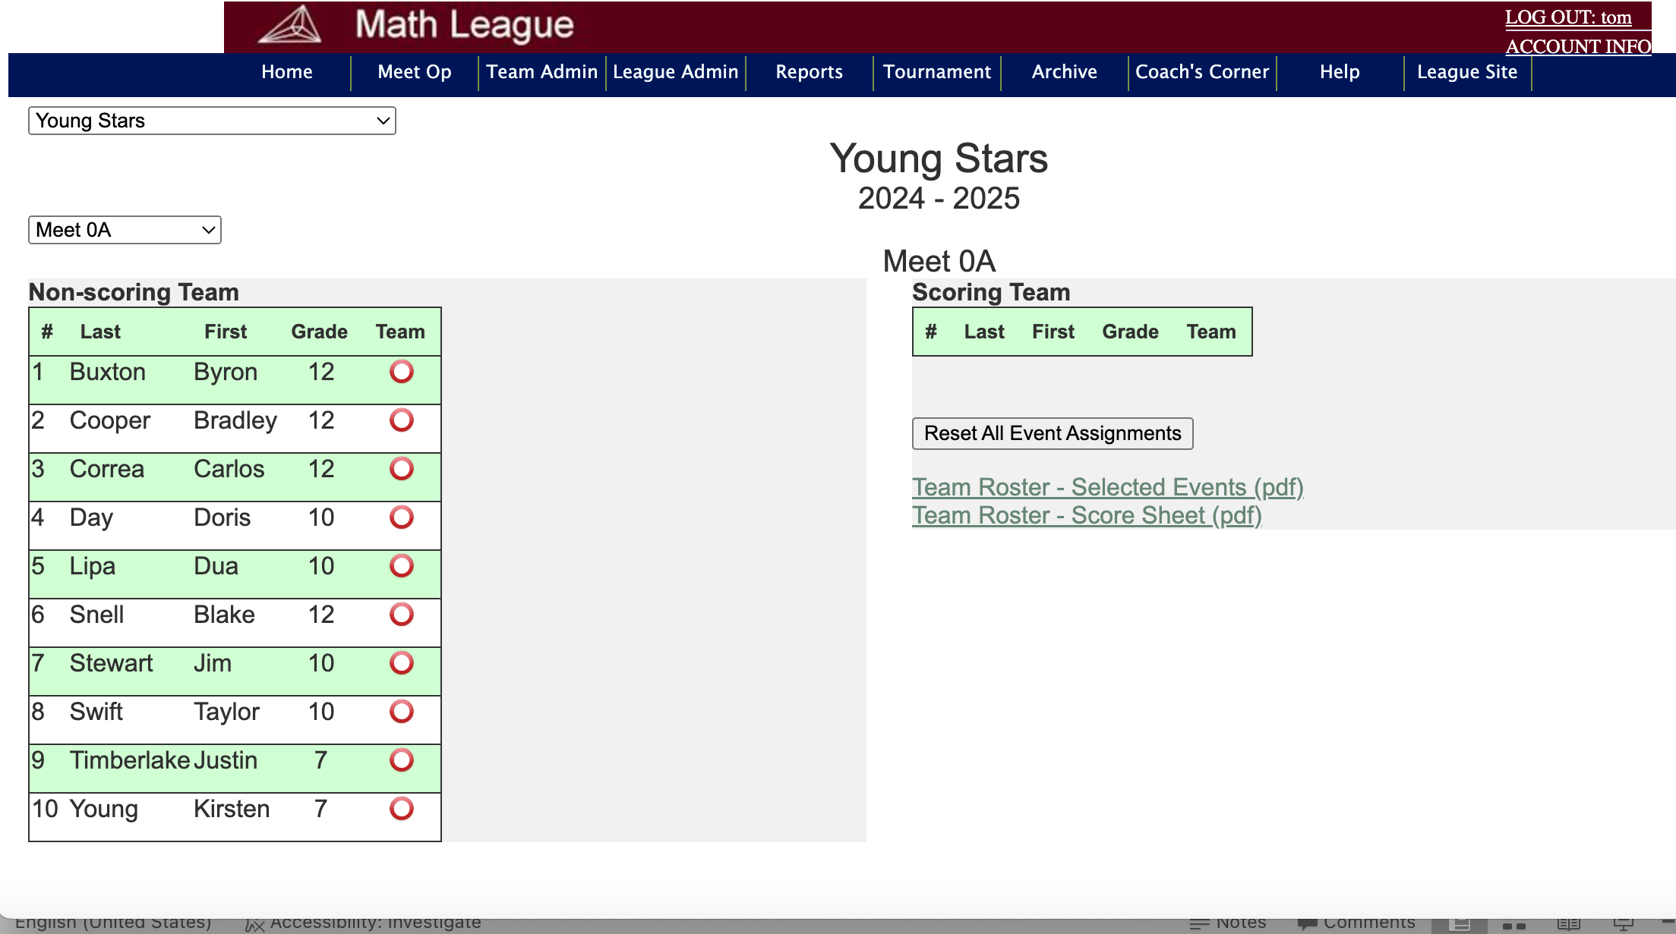
Your screen should look like this

Slide 14
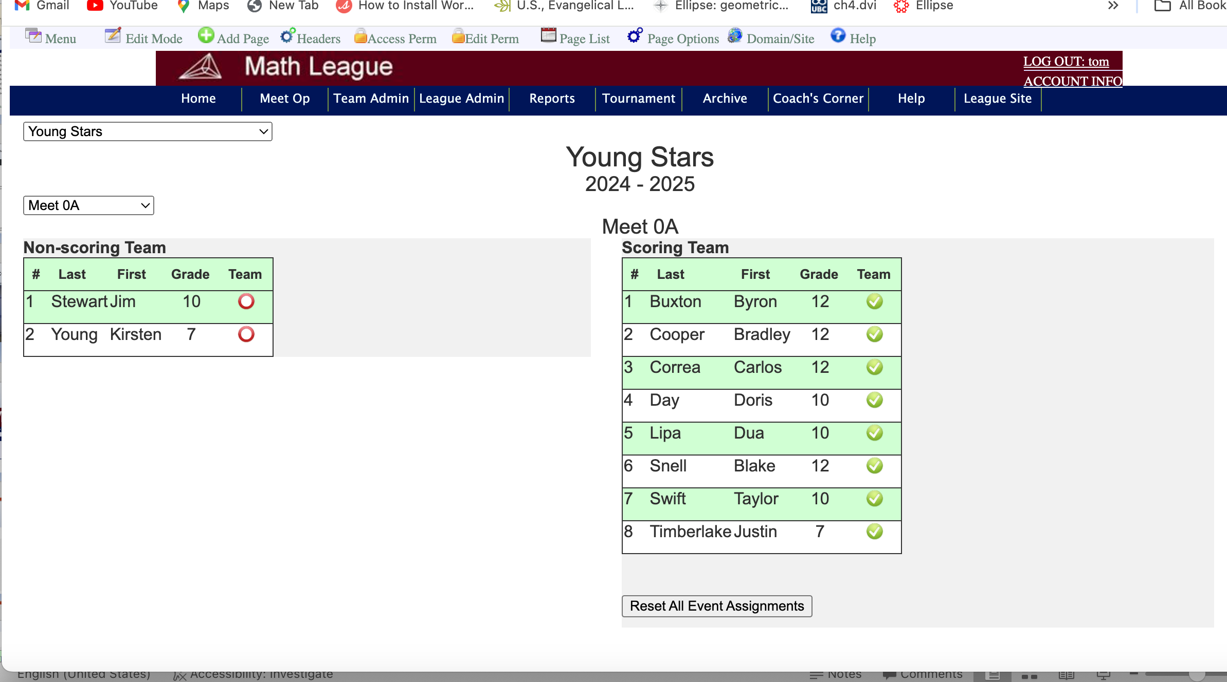
Select your 8 varsity players by clicking on their radio button
Playing for individual honors
Varsity
Select your 8 varsity players
Remember: at least 2 have to be 10th grade or younger

Slide 15
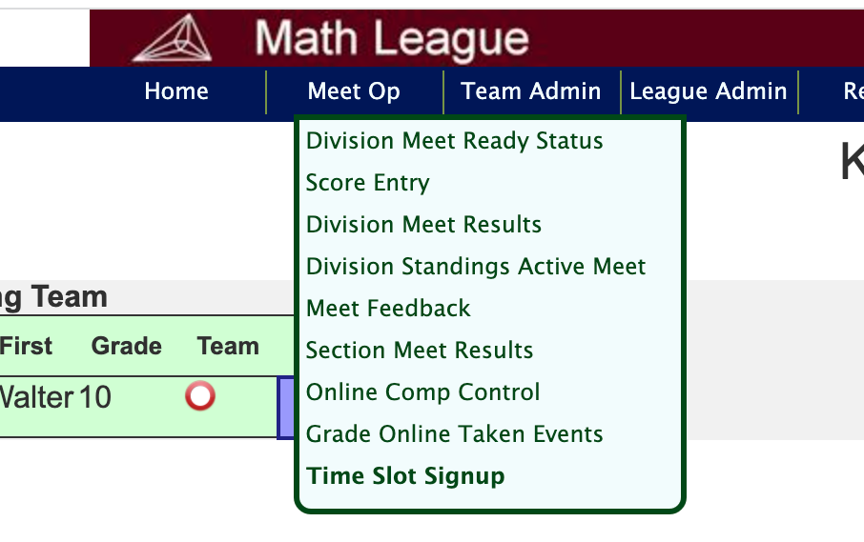
Sign up for a time slot.
Click on Meet op, then Time Slot sign up

Slide 16
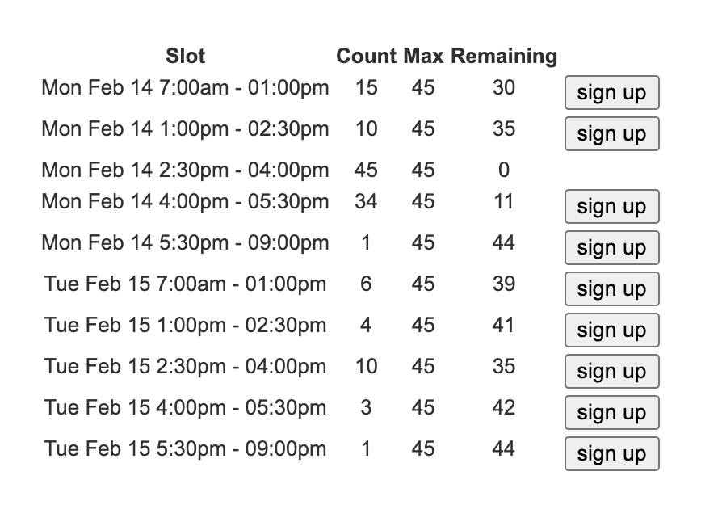
Pick a time. We went to slotted times so as to reduce server load

Slide 17
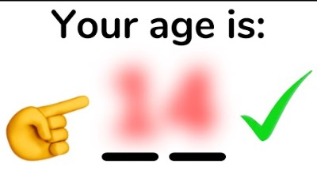
Cool is everywhere

Slide 18
You should now be ready to take a practice meet online.
Watch for emails that tell you when the online practice meet
is available.
Then you can sign up for a time slot and take the
practice meet when the day arrives.
The next set of Power Points will show you what to do the day of the meet

