Slide 2


MN State HS Math League
Conducting Online Meets
Administering Tests

Slide 3
So far, before the day of a Meet
You’ve entered the names of the students
    Team Admin –> Edit Team Roster
You’ve assigned them events
    Team Admin –> Team Meet Setup
You’ve gotten them usernames and passwords
    Team Admin –> Student Accounts
You’ve signed up for a time slot to do the Meet
    Meet Op –> Time Slot Signup
You’ve photocopied the tests for each student

Slide 4
What to do the Day of the Meet
a. Students should gather at your school at the slotted time
b. You as the coach of the team, need to log in and select recorder for team test
c. Have students sign in, hit Compete, and get ready for first test but not click the button to “watch” for the start.
d.. Hand out CLEAN Formula Sheet
e. Hand out Event A to each student, keeping them silent and instruct them not to look at the test until their online test starts
f. Only once you are ready for students to start, Click Start A
g. have students click the button to “watch” for the start. Their test should start shortly. Then they can turn over their sheets
h. Monitor Event A (15 minutes, all answers are integers, NO calculators, official answer is the computer entered answer)
i. Collect test when time expires. Give students a small break to talk
j Repeat steps for Events B and C
k. Non-varsity students are done. You can distribute/post Events A, B, C Solutions
l. gather varsity team of 8 together.
m. Distribute team test. They should not look at it yet. Only one person should be logged into the computer (the recorder)
n. start team test. The recorder should click their button to listen for the start of the team event.
The recorder should say when their computer has loaded the team event.
Only then may any students turn over their problem sheet for the team event.
(30 minutes all answers are integers, NO Calculator, official answer is the computer entered answer)
o. When team test done, double check (Verify) the scores from events and from team test.

Slide 5
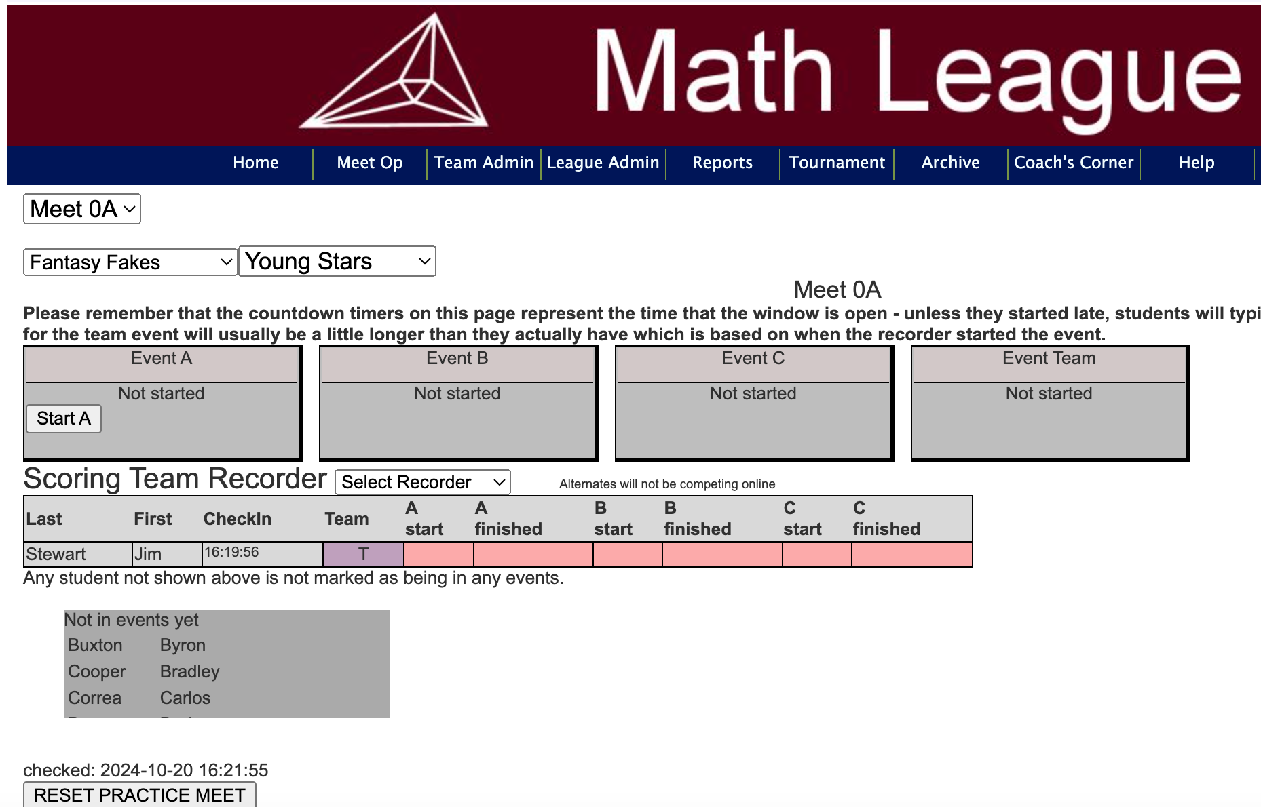
B. You (coach) should login to the website and
go to Meet Op -> Online Comp Control.
You screen should look something like this
Event controls
Note, non scoring members don’t take team test online. They could do a paper copy for fun
A
B
C
Team
Click on this button to select recorder for team test
Registered students show here
Unregistered students show here

Slide 6
Any member of the team can be recorder. Only the recorder should access online test. All others should do the test on paper and tell the recorder the answers so the recorder can enter them into the system

Slide 7
Have students sign in and get ready for first test
This is what the page looks like for the students when they sign in
It wouldn’t hurt to go over this information!

Slide 8
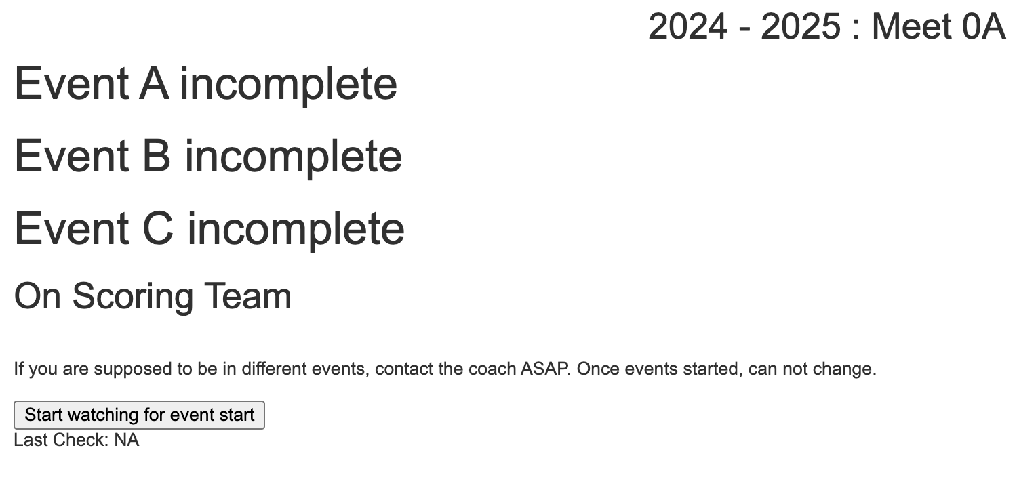
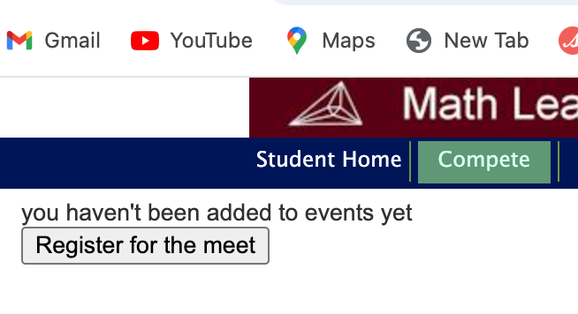
Students should click on the Compete button, they then have to hit Register for the Meet
Then it should show them what events they are taking.
If there is an error ,you can still fix it
They should not click “start watching for event start”

Slide 9
c. Hand out Event A to each student, keeping them silent and instruct them not to look at the test
until their online test starts
d. Only once you are ready for students to start, Click Start A
You can tell here if all the kids are checked in

Slide 10
e. have students click the button to “watch” for the start. Their test should start shortly. Then they can turn over their sheets

Slide 11
When individual tests are started by coach, it’ll look like the students have 20 minutes for test. That is actually the time frame in which the individual tests need to get done. Theoretically, a student can start their tests 5 minutes later. But why tempt fate??
Similarly, it’ll look like the team gets 35 minutes to take team test

Slide 12
When the student hits Submit, the test is over for the student.
Only hit Submit when you are done taking the test

Slide 13
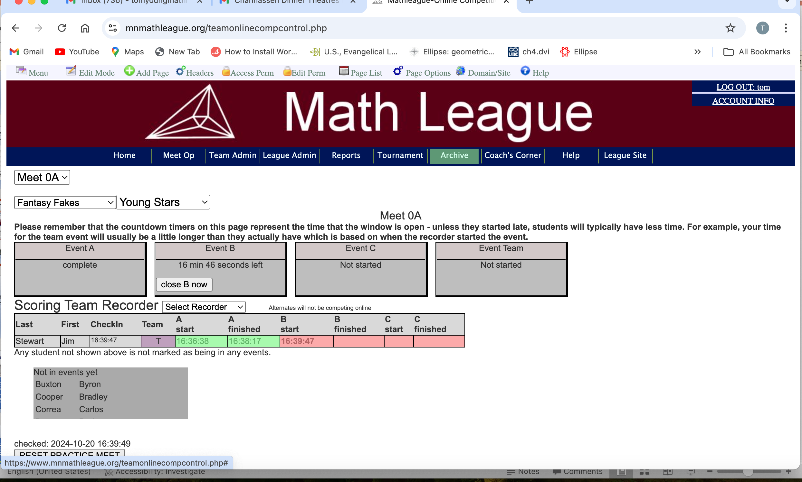
f. Monitor Event A. (15 minutes, all answers are integers,
NO calculators, official answer is the computer entered answer)
Once Event A is done, close it. Start B will appear. Repeat process

Slide 14
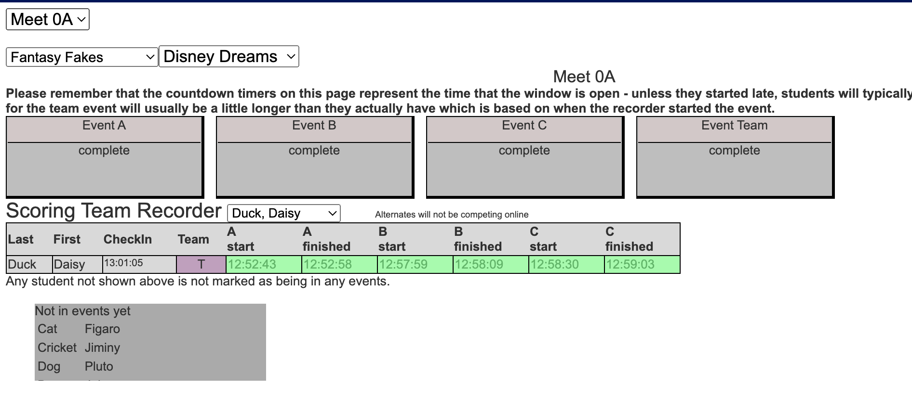
When all events A,B,C are done. distribute team test. Only one person should be logged into the computer (the recorder)

Slide 15
have recorder click the button to “watch” for the start. Their team test should start shortly. Then they can turn over their sheets

Slide 16
Hopefully all went well. If there are computer problems,
students can submit paper copy to coach.
Now you, as coach, need to verify their answers.
That’s for another PowerPoint.

